Slide 1
Erika Zimmermann Damer, University of Richmond Edamer@Richmond.edu Women’s Names in the Graffiti of Pompeii and Herculaneum
An application of the Ancient Graffiti Project

Slide 3
CIL no. |  | Text of Graffito | Location
 |  | Sabina, Sabina | Decumanus Max.
10517 |  | Sab(Inus? / Ina?) | IV. 2
10684 |  | Salar[ius] glabe® rusiunnae Lavinia(m) futui | Ramp
10693 |  | Vitalio | pedica ut comatus | Urosacula | Suurus (: Syrus?) | Foliatus | Vitalio | Ramp
10648 |  | Charca miam (:meam?), Sira (:Syra?) | Ins. Or. II.2-3
10676 |  | Hermeros Primigeniae dominae: | veni Puteolos in vico Tyaniano et quaere | a Messio numulario (:nummulario) Hermerotem Phoebi | Sub Baths
10577 |  | Procla (Greek) | V.18
10519 |  | Saturnina[e] | matr(i) uncus | assibus III
10508a |  | Amata
10547 |  | Crocale | barbata | IV.17
10525 |  | Hyacinthus hic fuit | Verginiam suam | IV.10
10646 |  | Iulaiam (:Iuliam?) | ad dom. | Ins. Or. 1.1a
10521 |  | Myrine mari | IV.8
10548 |  | Rufula p(ondo?) V s(emis?) | IV.17
10583b |  | Salvia Superba | V.31
10604a |  | [---acce]pit Secundus Crusali ser(vus?) | et Valentina ((:phallus)) | VI.1,7-10
10513 |  | AM | Surus | Ianua va(le) | IV.21
10649 |  | Amethyste va(le) | Ins.Or.II.2-3
10535 |  | Anicete va(le) | IV.15-16
10511 |  | Aniciae feliciter | III.19
10704 |  | [A]ve Fausta s(alutem) | Ramp
10697 |  | Fortunatus amat Amplianda | Ianuarius amat Veneria | Rogamus damna (:domina) Venus | ut nos in mente habias | quod te modo introrgamus | Ramp
10602 |  | Phlavia (:Flavia) θ li(n)gis | VI.1,7-10
10600 |  | Caves, Timinia | Iures | VI.1,7-10

Slide 4
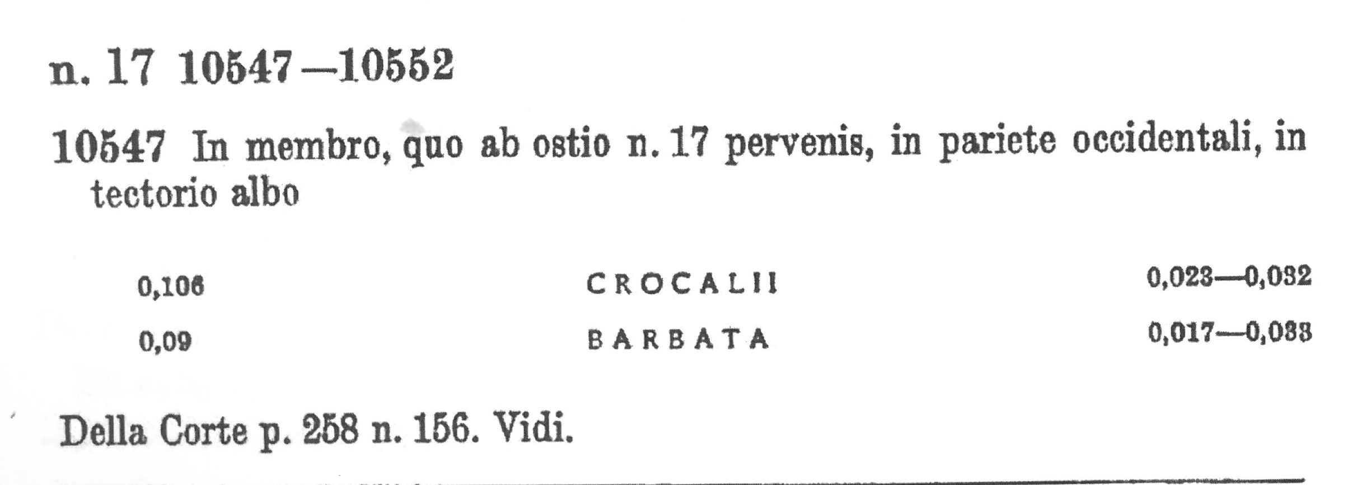
I. Traditional View of a Graffito (in CIL)
http://ancientgraffiti.org/Graffiti/graffito/AGP-EDR140131
Notes:
Here’s a simple graffito, although with the typescript intending to represent the appearance of graffito, One might think: Crocal -ii

Slide 5
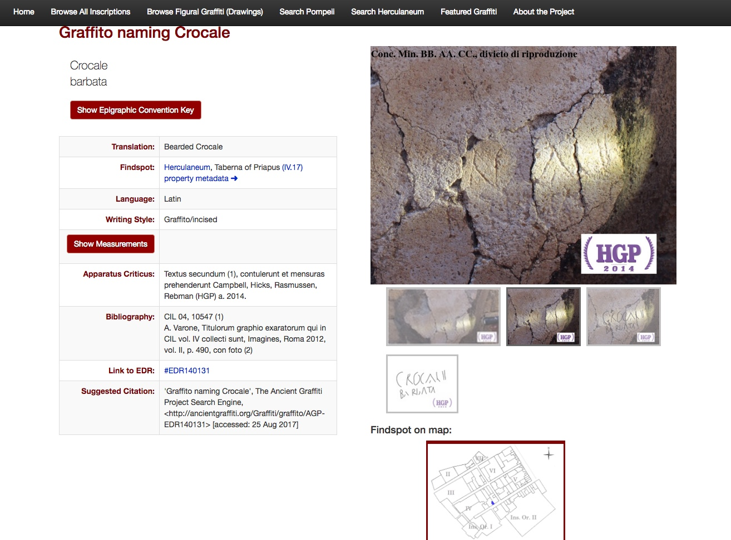
Notes:
All photos hosted by EDR

Slide 6
08367b | I.10.4 |  | 1.10.4 | Prim | Prim |  |  |  |  | Kajanto (1965, 291): CIL 1330 men; 705 women + sl/fr. 267: 40% of all cognomina for women were birth order derived: Primus/Primigenius is 40% of these |  |  | Castren (1983, 258): s.v. Antistia P. f. Prima; Caesia Prima; Pithia Prima (this); Siccia Prima
8770e | II.7.1 |  | Campus | Prima - Q - Q - Q | Prima |  |  |  |  | Kajanto (1965, 291): CIL 1330 men; 705 women + sl/fr. 267: 40% of all cognomina for women were birth order derived: Primus/Primigenius is 40% of these |  |  | Castren (1983, 258): s.v. Antistia P. f. Prima; Caesia Prima; Pithia Prima (this); Siccia Prima
8771b | II.7.1 |  | Campus | Dorcas | Prima | Prima |  |  |  |  | Kajanto (1965, 291): CIL 1330 men; 705 women + sl/fr. 267: 40% of all cognomina for women were birth order derived: Primus/Primigenius is 40% of these |  |  | Castren (1983, 258): s.v. Antistia P. f. Prima; Caesia Prima; Pithia Prima (this); Siccia Prima
10153 | II.7.10 |  |  | Prima cum suo hac | Prima |  |  |  |  | Kajanto (1965, 291): CIL 1330 men; 705 women + sl/fr. 267: 40% of all cognomina for women were birth order derived: Primus/Primigenius is 40% of these |  |  | Castren (1983, 258): s.v. Antistia P. f. Prima; Caesia Prima; Pithia Prima (this); Siccia Prima
10156 | II.7.10 |  |  | Prima cum sparitundiolo modo hac | Prima |  |  |  |  | Kajanto (1965, 291): CIL 1330 men; 705 women + sl/fr. 267: 40% of all cognomina for women were birth order derived: Primus/Primigenius is 40% of these |  |  | Castren (1983, 258): s.v. Antistia P. f. Prima; Caesia Prima; Pithia Prima (this); Siccia Prima
10157 | II.7.10 |  |  | Prima | Prima |  |  |  |  | Kajanto (1965, 291): CIL 1330 men; 705 women + sl/fr. 267: 40% of all cognomina for women were birth order derived: Primus/Primigenius is 40% of these |  |  | Castren (1983, 258): s.v. Antistia P. f. Prima; Caesia Prima; Pithia Prima (this); Siccia Prima
8241 | I.10.2 |  |  | Prima domina (?) | Prima domina (?) |  |  |  |  | Kajanto (1965, 291): CIL 1330 men; 705 women + sl/fr. 267: 40% of all cognomina for women were birth order derived: Primus/Primigenius is 40% of these |  |  | Castren (1983, 258): s.v. Antistia P. f. Prima; Caesia Prima; Pithia Prima (this); Siccia Prima
08367a | I.10.4 |  | 1.10.4 | Prima domina (?) | Prima domina (?) |  |  |  |  | Kajanto (1965, 291): CIL 1330 men; 705 women + sl/fr. 267: 40% of all cognomina for women were birth order derived: Primus/Primigenius is 40% of these |  |  | Castren (1983, 258): s.v. Antistia P. f. Prima; Caesia Prima; Pithia Prima (this); Siccia Prima
8364 | I.10.4 |  | 1.10.4 | Secundus |Primae suae ubique isse salute(m) | Rogo domina ut me ames | Prima sua |  |  |  |  | Kajanto (1965, 291): CIL 1330 men; 705 women + sl/fr. 267: 40% of all cognomina for women were birth order derived: Primus/Primigenius is 40% of these |  |  | Castren (1983, 258): s.v. Antistia P. f. Prima; Caesia Prima; Pithia Prima (this); Siccia Prima
8365 | I.10.4 |  | 1.10.4 | Secundus |Primae suae | secund | Prima sua |  |  |  |  | Kajanto (1965, 291): CIL 1330 men; 705 women + sl/fr. 267: 40% of all cognomina for women were birth order derived: Primus/Primigenius is 40% of these |  |  | Castren (1983, 258): s.v. Antistia P. f. Prima; Caesia Prima; Pithia Prima (this); Siccia Prima
8175 | I.7.19 |  |  | Primigen . . | Va(le) Salute(m) | Primigen . . . |  |  | Primigenia |  | Kajanto (1965, 76 chart): 40% of all cognomina for women were birth order derived; Primus / Primigenius is 40% of those); 5403 free women in empire; 832 sl/fr women); abs. number is 335 + sl/fr. 91
08373b | I.10.4 |  | 1.10.4 | Apolinar | Primigeniae | Plu(rimum salutem) | Primigenia |  |  | Primigenia |  | Kajanto (1965, 76 chart): 40% of all cognomina for women were birth order derived; Primus / Primigenius is 40% of those); 5403 free women in empire; 832 sl/fr women); abs. number is 335 + sl/fr. 91 |  |  | Castren (1983, 258): s.v. Cornelia Primigenia; Iulia Primigenia; Sutoria Primigenia
8769c | II.7.1 |  | Campus | Pittacius | cum | Primigenia | hic. Prima, seq- | uere. Volu-| mnius | Primigenia |  |  |  |  |  |  |  | Castren (1983, 258): s.v. Cornelia Primigenia; Iulia Primigenia; Sutoria Primigenia
8988 | IX.14.b |  | Regio III. Ins. Obelli Firmi. "non adhuc numerata" | PrMigenia | Primigenia |  |  |  |  |  |  |  | Castren (1983, 258): s.v. Cornelia Primigenia; Iulia Primigenia; Sutoria Primigenia
9136 | IX.13.5 |  | Regio IX. Ins. XIII.5 | SS II X I Primigenia | Multa | . . . . | Primigenia | Multa |  |  |  |  | Kajanto (1965, 76 chart): 40% of all cognomina for women were birth order derived; Primus / Primigenius is 40% of those); 5403 free women in empire; 832 sl/fr women); abs. number is 335 + sl/fr. 91 |  |  | Castren (1983, 258): s.v. Cornelia Primigenia; Iulia Primigenia; Sutoria Primigenia
8770a | II.7.1 |  | Campus | Primigenia cum Prima | Primigenia cum Prima |  |  |  |  | Kajanto (1965, 76 chart): 40% of all cognomina for women were birth order derived; Primus / Primigenius is 40% of those); 5403 free women in empire; 832 sl/fr women); abs. number is 335 + sl/fr. 91 |  |  | Castren (1983, 258): s.v. Cornelia Primigenia; Iulia Primigenia; Sutoria Primigenia
10241 | Sepulcrum 23 |  | Sepulcrum 23 | Primigeniae | Nucerinae Sal(utem) | Vellem essem gemma (h)ORA(m?) non amplius ma | ut tibi signanti oscula missa darem | Primigenia Nucerina |  |  |  |  | Kajanto (1965, 76 chart): 40% of all cognomina for women were birth order derived; Primus / Primigenius is 40% of those); 5403 free women in empire; 832 sl/fr women); abs. number is 335 + sl/fr. 91 |  |  | Castren (1983, 258): s.v. Cornelia Primigenia; Iulia Primigenia; Sutoria Primigenia
8360 | I.10.4 |  | 1.10.4 | Primilla Val(e) | Primilla Val(e) |  |  | Primilla |  | Kajanto (1965, 291): CIL 129 + 17 sl/fr (78 out of 149 total in Rome)

Slide 7
Graffiti Clusters of 50 or More in Privately-Owned, and Public Spaces in the Unindexed Supplement III (Modified from Keegan 2010, 172)
House | Number of Recorded Graffiti | Number of Graffiti that mention / name women | CIL Reference
1.7.1, 20: Casa di C. Cuspius Pansa | 86 | 2 | CIL 4.8067-8135
1.10.4: Casa dei Q.Q. Poppaei Sabini (Casa di Menandro) | 147 | 19 | CIL 4.8285- 8357
Villa dei Misteri | 108 | 12 | CIL 4.9176-9247
II.7.1: Grande Palestra | 295 | 29 | CIL 4.8518 - 8814
House | Number of Recorded Graffiti | Number of Graffiti that mention / name women | CIL Reference
1.7.1, 20: Casa di C. Cuspius Pansa | 86 | 2 | CIL 4.8067-8135
1.10.4: Casa dei Q.Q. Poppaei Sabini (Casa di Menandro) | 147 | 19 | CIL 4.8285- 8357
Villa dei Misteri | 108 | 12 | CIL 4.9176-9247
II.7.1: Grand Palaestra | 295 | 29 | CIL 4.8518 - 8814

Slide 8
Names of Women that appear in the Graffiti (117)

Slide 9
Roman Name
For men, by the late Republic, the tria nomina:
Praenomen, Nomen Gentilicium, Cognomen
e.g. Marcus Tullius Cicero
For women, among the most elite, women may have retained only the Nomen Gentilicium in the feminine form:
e.g. Tullia
Most women also had a cognomen:
e.g. Salvia Superba (CIL 4.10538 b, Herculaneum)

Slide 10
Names of Women that appear in the Graffiti (117)

Slide 11
The most commonly appearing names and their frequencies.

Slide 12
Women with two or more names
Celerina Spuri f(ilia),
Assellam Flaviam,
Poppaea Triquinia (:Tarquinia),
Novellia Primigenia of Nuceria,
Sit(t)ia Pro(cula?),
Mulvia Prisca mater.

Slide 15
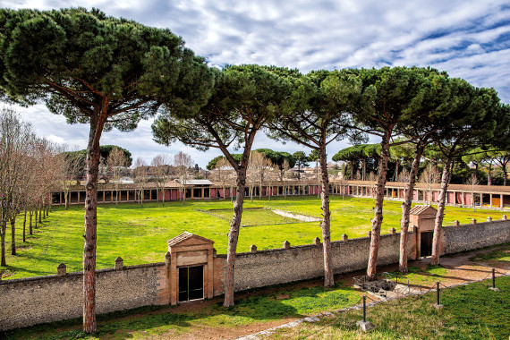
Views of the Grande Palaestra

Slide 16
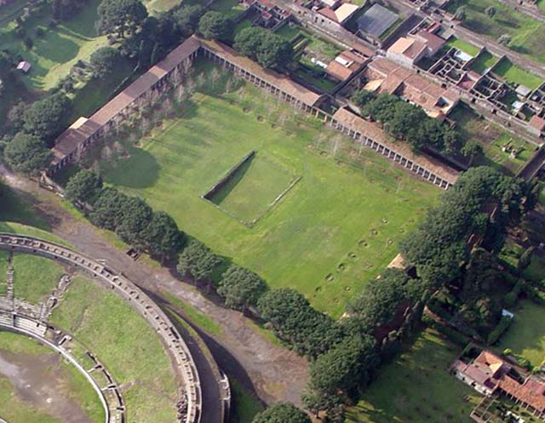

Slide 17
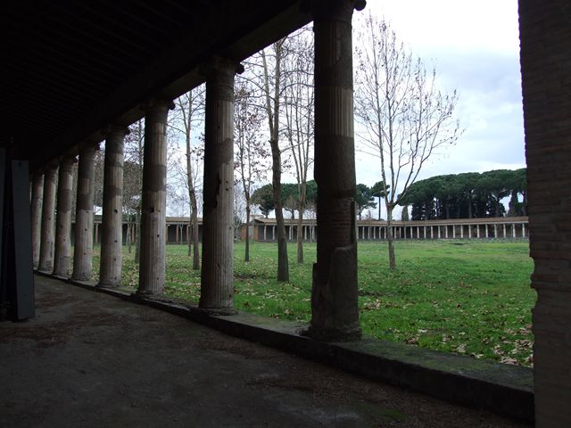
Grande Palaestra: some of the plaster from the columns of the Ambulacra is visible

Slide 21
Works Cited
Abbema, Laura. 2016. “Women in Flavian Rome.” In A Companion to the Flavian Age of Imperial Rome., 296-. Blackwell.
Baird, Jennifer A., and Claire Taylor, eds. 2011. Ancient Graffiti in Context. Routledge Studies in Ancient History, v. 2. New York: Routledge.
Baird, Jennifer, Claire Taylor. 2010. Ancient Graffiti in Context. Routledge.
Benefiel, R. 2010. “Dialogues of Graffiti in the House of the Four Styles at Pompeii (Casa Dei Quattro Stili, 1.8.17, 11).L.V.P. or Quatro Stili. in Laird and Taylor.Pdf.” n.d.
Benefiel, Rebecca, and Peter Keegan, eds. 2016. Inscriptions in the Private Sphere in the Greco-Roman World. Leiden ; Boston: Brill.
Bodel, John. 2012. Epigraphic Evidence: Ancient History From Inscriptions. Hoboken: Taylor and Francis.
Buonopane, Alfredo, and Francesca Cenerini. 2003. Donna e lavoro nella documentazione epigrafica: atti del 1. Seminario sulla condizione femminile nella documentazione epigrafica : Bologna, 21 novembre 2002. Lega.
———. 2005. Donna e vita cittadina nella documentazione epigrafica: atti del II Seminario sulla condizione femminile nella documentazione epigrafica, Verona, 25-27 marzo 2004. Fratelli Lega.
Cooley, Alison Elizabeth, and Melvin George Lowe Cooley. 2014. Pompeii and Herculaneum: A Sourcebook.
Della Corte, Matteo. n.d. “Le iscrizioni della ‘Grande Palestra’ ad occidente dell’Anfiteatro.” 1939, Notizie degli scavi di antichità, 64: 239–327.
“Dialogues of Graffiti in the House of the Four Styles at Pompeii (Casa Dei Quattro Stili, 1.8.17, 11).L.V.P. or Quatro Stili. in Laird and Taylor.Pdf.” n.d.
Ferri, Rolando. 2009. Review of Review of: Latin Vulgaire--Latin Tardif VIII: Actes Du VIIIe Colloque International Sur Le Latin Vulgaire et Tardif, Oxford, 6-9 Septembre 2006, by Roger Wright. Bryn Mawr Classical Review, February. http://bmcr.brynmawr.edu/2009/2009-02-50.html.
Foss, Pedar, and John J. Dobbins. 2009. The World of Pompeii. Routledge.
Heikki, Solin. n.d. “Ancient Onomastics: Perspectives and Problems,” 9.
Hemelrijk, Emily Ann. 1999. Matrona Docta: Educated Women in the Roman Élite from Cornelia to Julia Domna. Routledge Classical Monographs. London ; New York: Routledge.
Hemelrijk, Emily Ann, and Greg Woolf, eds. 2013. Women and the Roman City in the Latin West. Mnemosyne. Supplements. History and Archaeology of Classical Antiquity, volume 360. Leiden ; Boston: Brill.
Kajanto, Iiro. 1982. The Latin Cognomina. Commentationes Humanarum Litterarum 36, 2. Roma: G. Bretschneider Editore.
Kajava, Mika. 1994. Roman Female Praenomina: Studies in the Nomenclature of Roman Women. Acta Instituti Romani Finlandiae, vol. 14. Rome: Institutum Romanum Finlandiae.
Keegan. 2010.”Graffiti and Social Media as Memory Traces.” in Laird and Taylor.
Keegan, Peter. 2014. Graffiti in Antiquity. London: Routledge.
McGinn, Thomas. 2004. The Economy of Prostitution in the Roman World: A Study of Social History and the Brothel. University of Michigan Press.
Milnor, Kristina. 2014. Graffiti and the Literary Landscape in Roman Pompeii. OUP Oxford.
“NOVA BIBLIOTHECA POMPEIANA. Repertorium Bibliographicum Pompeianum.” n.d.
Petersen, Lauren Hackworth. 2011. The Freedman in Roman Art and Art History. Cambridge University Press.
Sarah Levin-Richardson. 2013. “FUTUTA SUM HIC: FEMALE SUBJECTIVITY AND AGENCY IN POMPEIAN SEXUAL GRAFFITI.” The Classical Journal 108 (3): 319.
Savunen, Liisa. 1997a. Women in the Urban Texture of Pompeii. University of Helsinki.
Setälä, Päivi, and Liisa Savunen. 1999. Female Networks and the Public Sphere in Roman Society. Rome: Institutum Romanum Finlandiae.
Solin, Heikki. 1996. Die stadtrömischen Sklavennamen: ein Namenbuch. 3 volumes. Franz Steiner Verlag.
Sypniewski, H. and R. Benefiel. 2018. “The Greek Graffiti of Herculaneum.” AJA 122.2.
Väänänen, Veikko. 1966. Le latin vulgaire des inscriptions pompéiennes. Berlin: Akademie-Verlag.
Varone, A. 2000. Spigolature Epigraphiche Ercolanesi. Rivista Di Studi Pompeiani. 11:276-281.” n.d.
Varone, Antonio. 2002. Erotica Pompeiana: Love Inscriptions on the Walls of Pompeii. Studia Archaeologica 116. Roma: L’Erma di Bretschneider.
———. 2012. Titulorum graphio exaratorum qui in CIL vol. IV collecti sunt: imagines. Roma: Ministero per i beni e le attività culturali, Soprintendenza speciale per i beni archeologici di Napoli e Pompei : L’Erma di Bretschneider.
Zissos, Andrew. 2016. A Companion to the Flavian Age of Imperial Rome. Blackwell Companion. Blackwell.
Ancientgraffiti.org

Slide 22

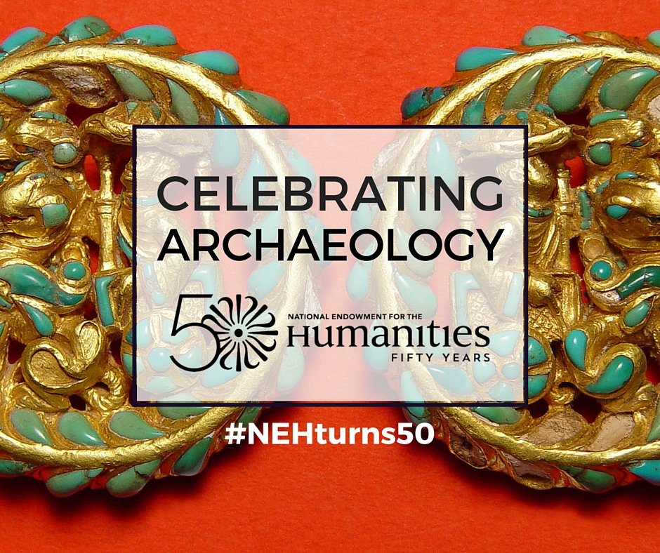


With Thanks to: Questions? Contact: benefielr@wlu.edu Our thanks to:

